Slide 1
MANAGE YOUR MEMBERSHIP
Contact Information and Demographics
Member only Discount Codes
Service Officer Contacts
Online Publications, and Subscriptions
Print Membership Card
Automatic Renewal Setup
2027
Notes:
MyLegion is a secure website for American Legion and Sons of the American Legion members.

Slide 2
ABOUT MYLEGION
Notes:
MyLegion provides The American Legion and Sons of The American Legion members online access to their membership details and management tools. It also gives administrative officer’s tools for membership management and reports.
MyLegion allow members to renew online and set renewal preferences. Administrative officers of posts and squadrons can process membership online through their registered myLegion account.

Slide 3
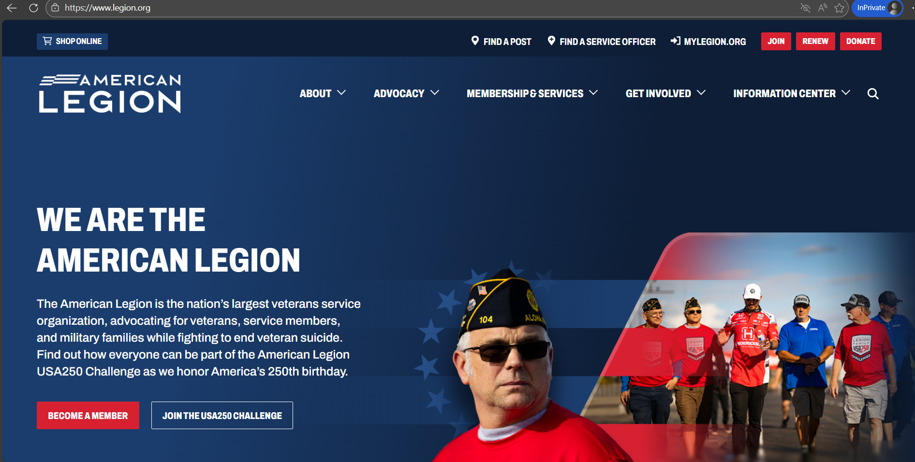

LEGION.ORG Online Renew
Notes:
Before we begin with mylegion, members should regularly check national headquarters public website Legion.org. This site keeps you up to date with American Legion programs and resources.
Members can renew without logging into myLegion by clicking “Renew”.

Slide 4
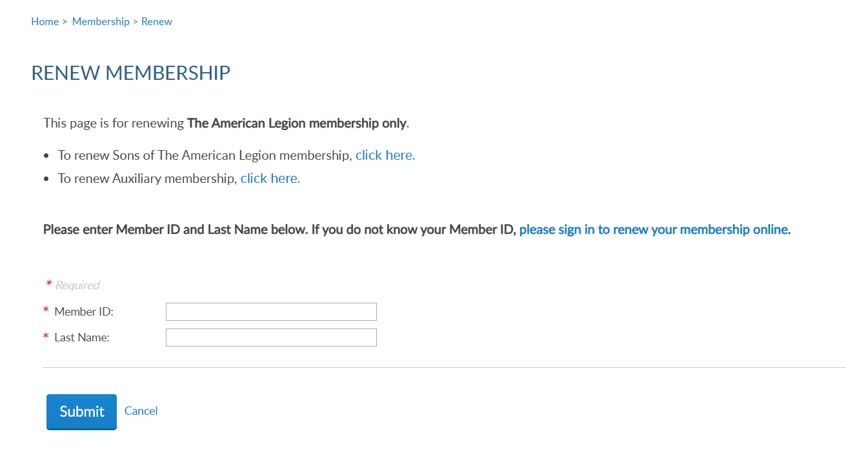
ONLINE RENEWAL: “QUICK PAY”
Notes:
This directs you to begin your renewal with your member ID and last name to proceed.

Slide 5
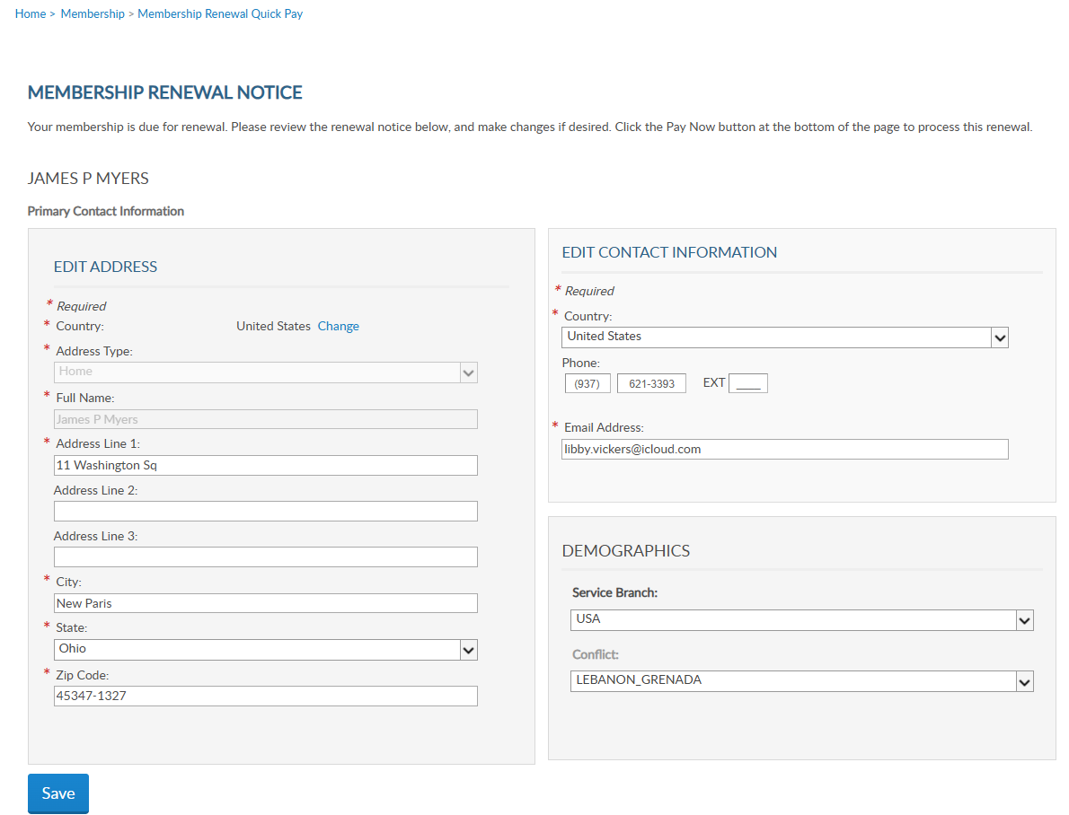
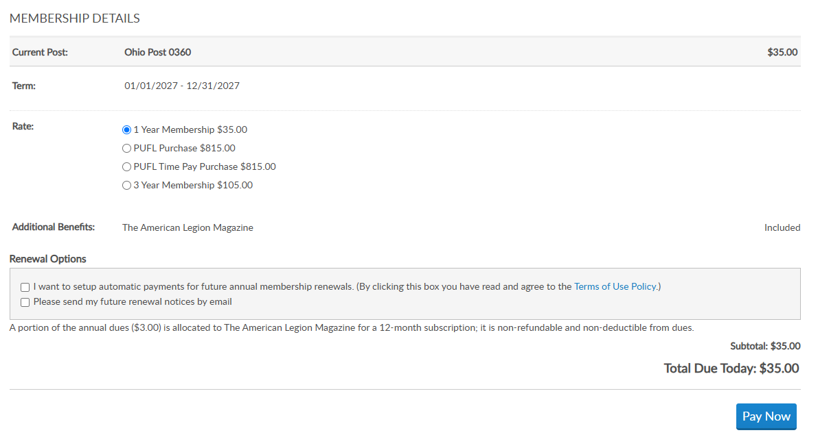
ONLINE RENEWAL: “QUICK PAY”
SAMUEL SAMPLE
555-5555
Samuel Sample
123 Main St
ssample@gmail.com
Notes:
The online renewal notice allows you to update contact information and demographic information. <1> Scroll down to view rate options and set up renewal options. Select “Pay Now” to enter payment information.

Slide 6
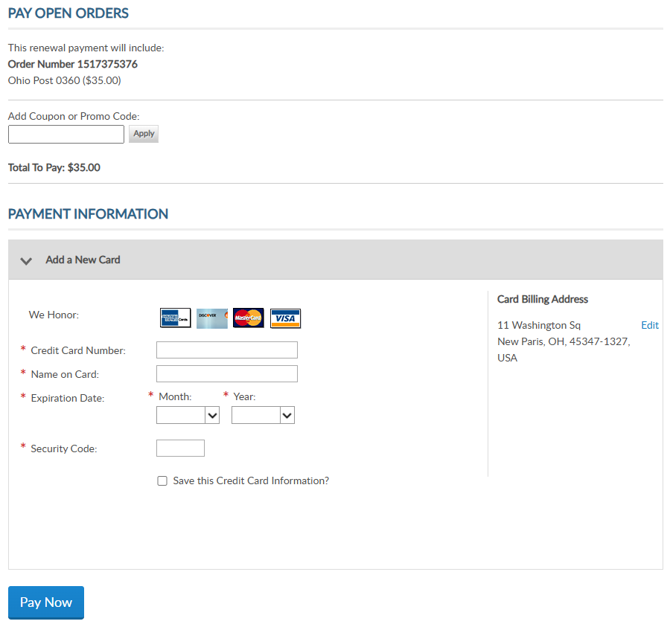
ONLINE RENEWAL: “QUICK PAY”
123 E Main St
New Paris, OH 45347
USA
Notes:
Enter credit card information and select “Pay Now”.

Slide 7
myLEGION.ORG
Notes:
Members can also renew through their myLegion account, manage payment and member information and much more. Select the link to www.legion.org.

Slide 8
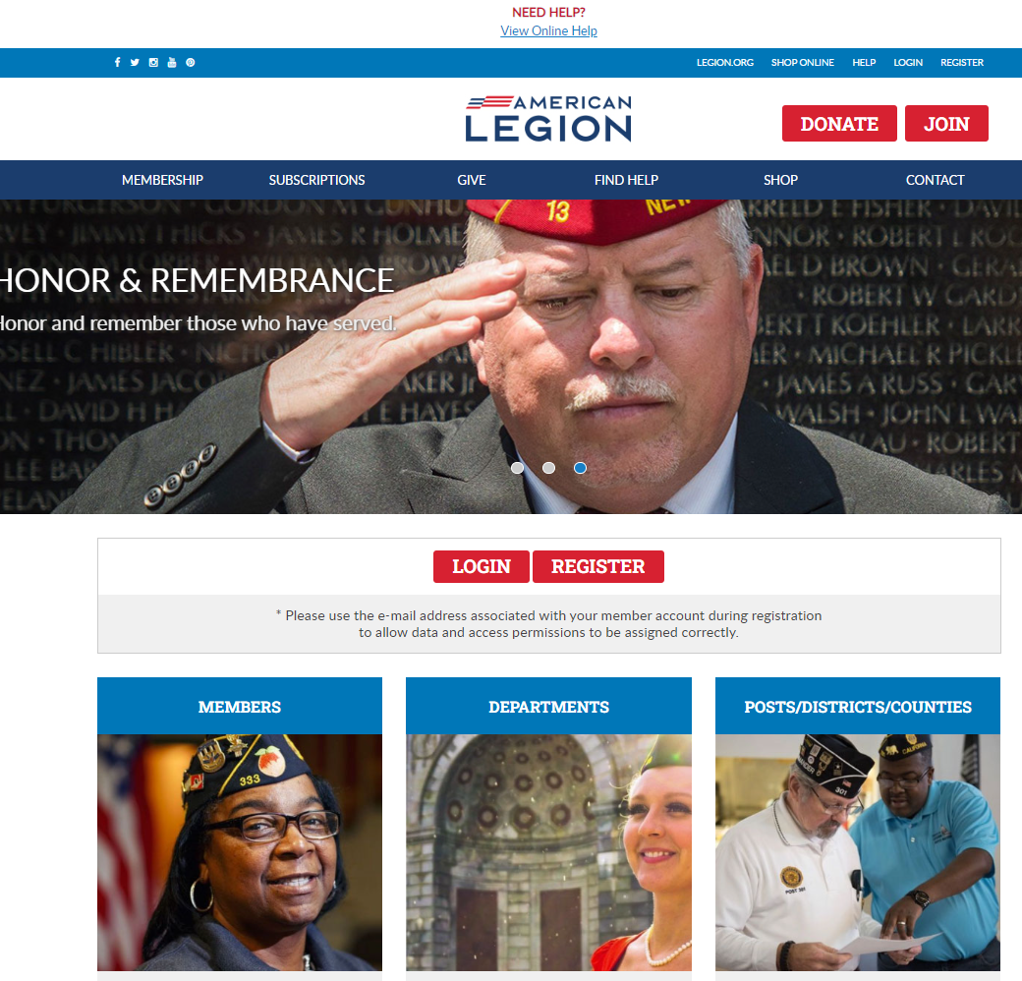

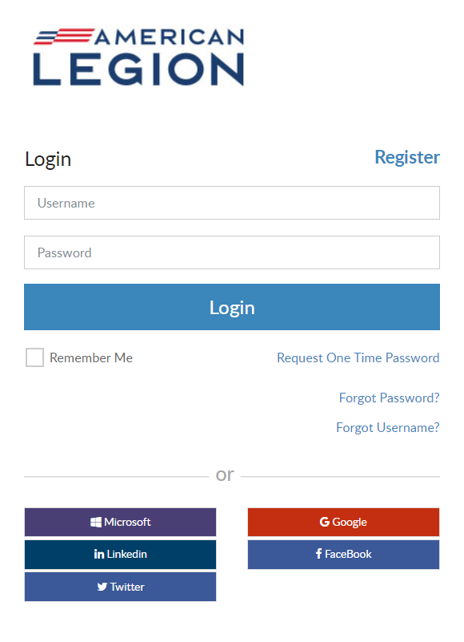
Log in or register a myLegion account to view and manage membership.
Notes:
Begin by logging in with your username and password. If you don’t have an account, click register to create one using the email address on your membership record.

Slide 9
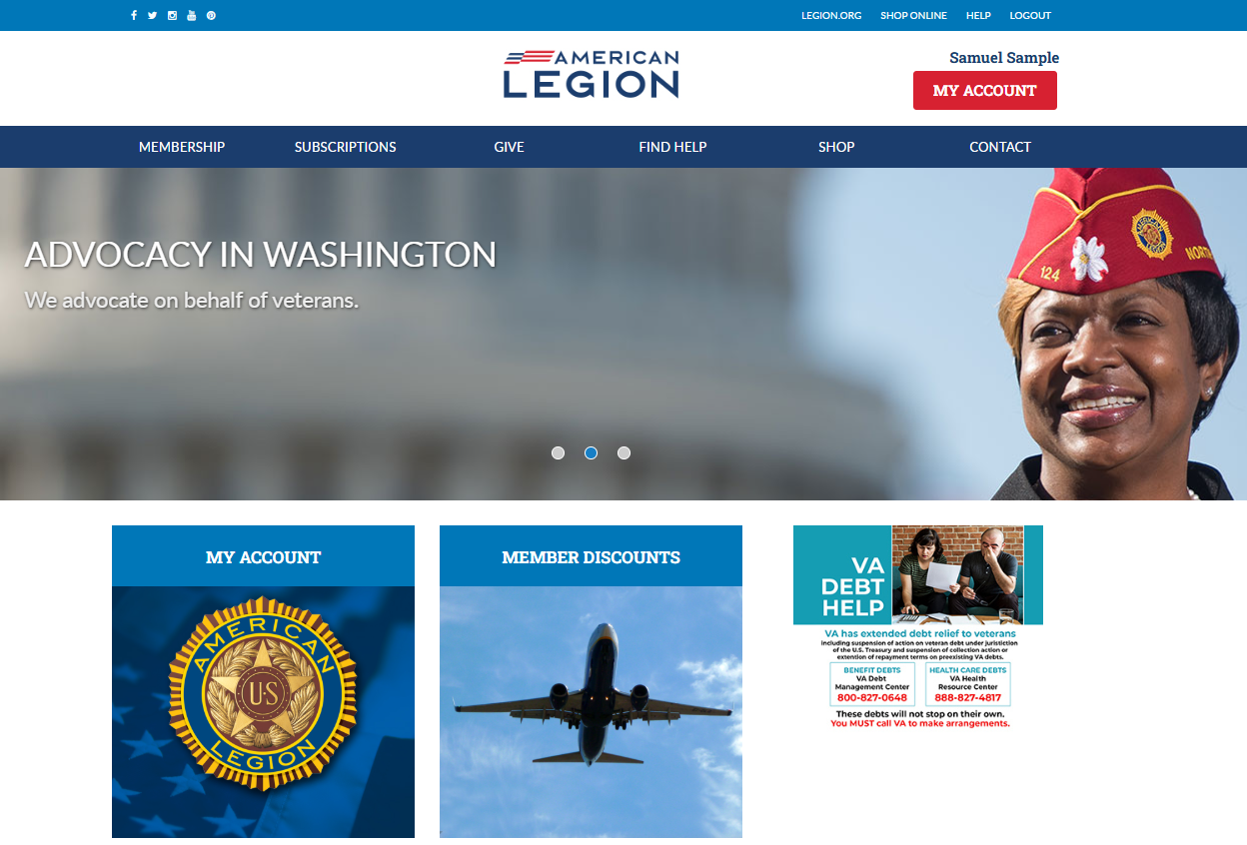
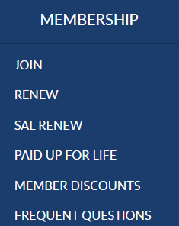
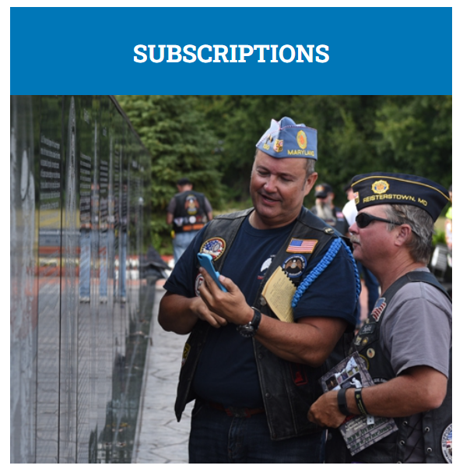
Notes:
From the MyLegion home page you will find menus that include links to membership, subscriptions, donations, help resources, Flag & Emblem and contact information.
Membership links include online join for Legion members only, online renewal quick pay, and Paid Up for Life information. Paid Up for Life is a national program for Legion members only. Use these links to view member discounts, and frequently asked questions about membership eligibility.

Slide 10
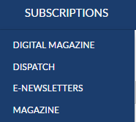
Notes:
Membership in The American Legion includes The American Legion Magazine in digital format from the Subscriptions menu, a link to monthly Dispatch articles and set up options for online E-Newsletters.

Slide 11
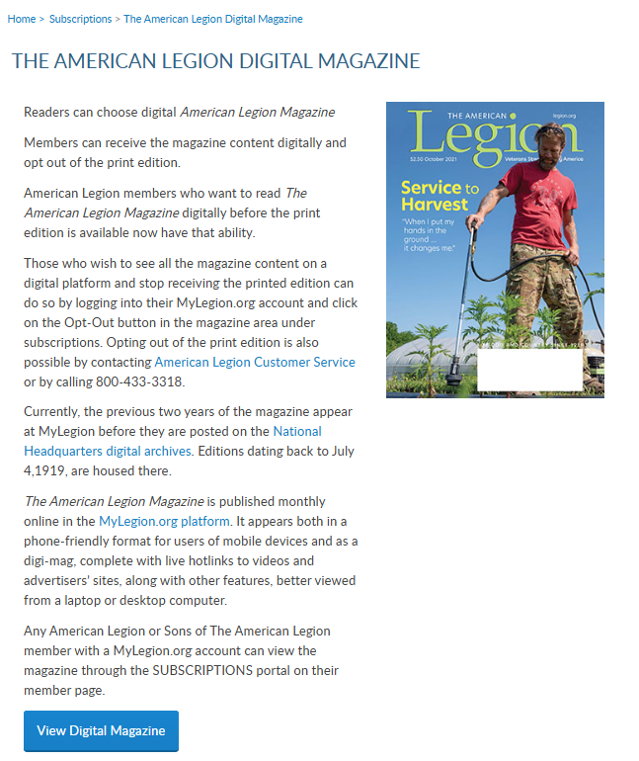
Notes:
. Digital magazine provides contact information for national staff to assist with opting in and out of digital magazine subscriptions.
You will also find the link to request past publications through National Headquarters digital archives.

Slide 12
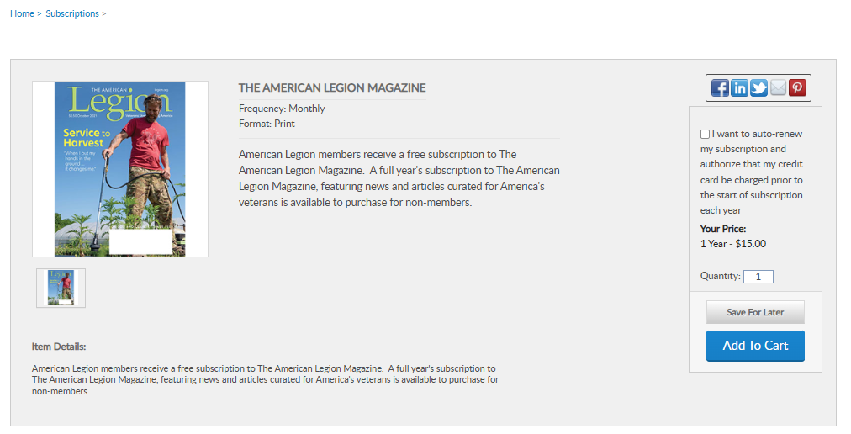
Notes:
The Magazine option at the bottom of the list provides a link for non-members to purchase and renew their subscription or members to purchase additional subscriptions.

Slide 13
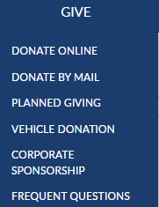
Notes:
Online giving opportunities can be set up through a MyLegion account. The give menu provides information about planned giving, vehicle donations and corporate sponsorships. Questions about giving to American Legion charities are answered in frequent questions.

Slide 14
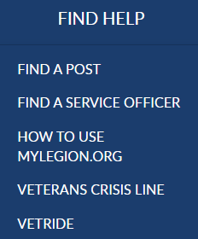
Notes:
Resources help you find a post or accredited service officers with step-by-step help documentation to assist with MyLegion tools for members and leadership. Links to veteran’s crisis line and Vet Ride are also available.

Slide 15
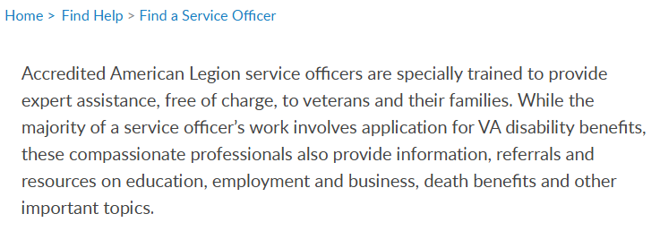
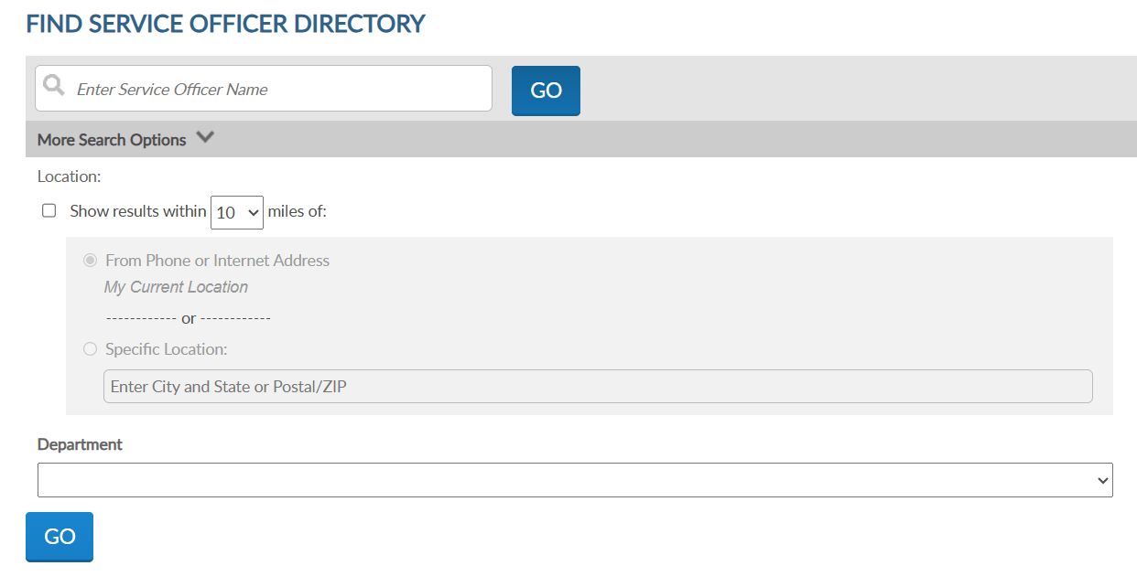
Notes:
Using the service officer directory, you can enter your state and distance to find one near you.

Slide 16
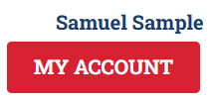
Notes:
The Shop link navigates to National Flag & Emblem and Contact re-directs to legion.org’s National HQ directory.
To view membership details and manage your account click on My Account. <1>

Slide 17
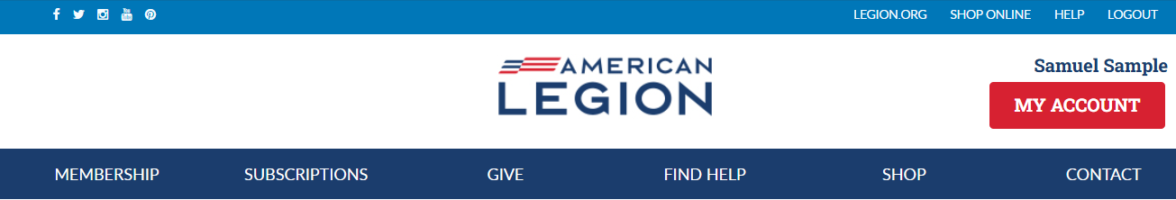
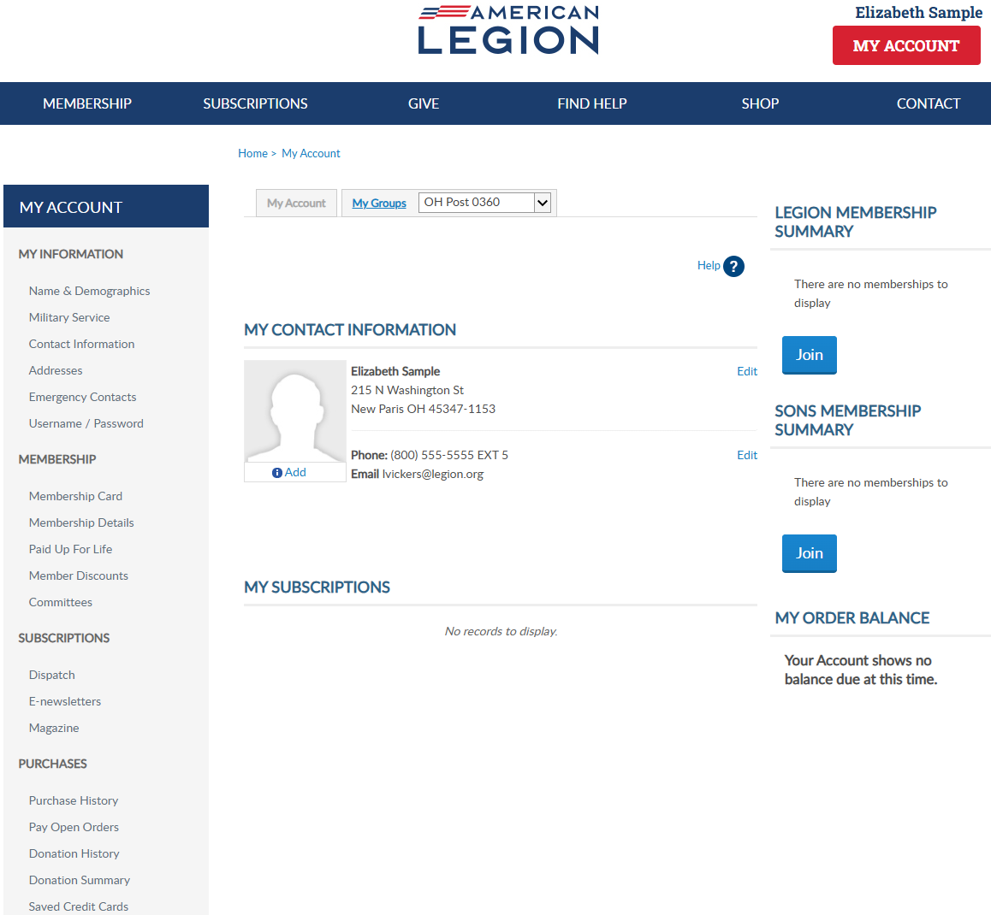
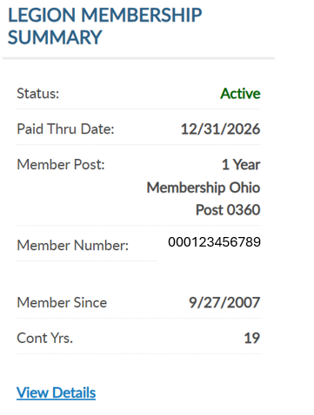
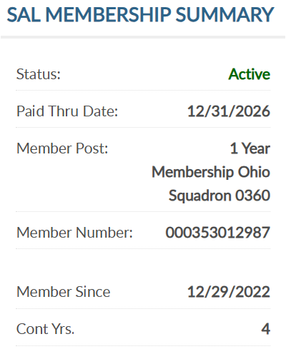
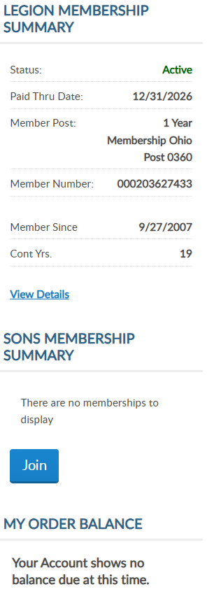
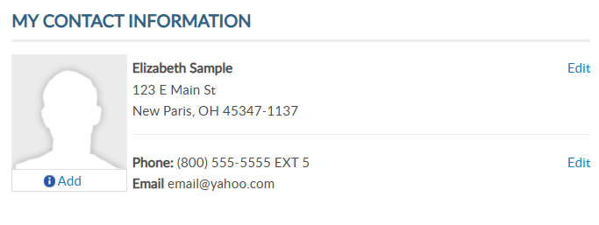
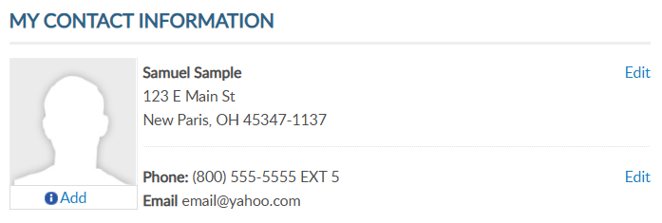
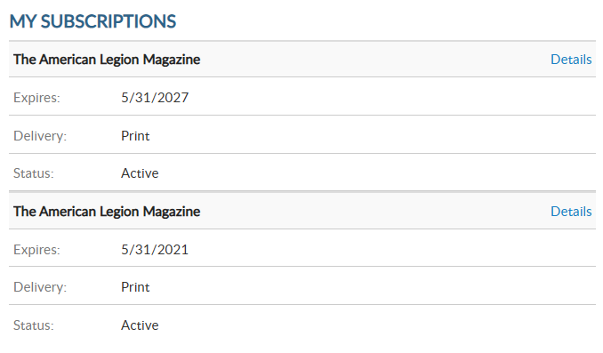


12/31/2027
12/31/2027
12/31/2027
000123456789
20
000123456789
20
5
5/31/2028
12/31/2027
000123456789
5
Notes:
My Account provides membership detail summaries for American Legion and Sons of the American Legion membership. <1> It include member status, renewal status, post and squadron number, member ID, join date and continuous years. <2> Members of both The American Legion and SAL are known as dual members and will have the same membership ID#.
When a renewal is available the renew now button will display. To renew, click the renew now button.

Slide 18
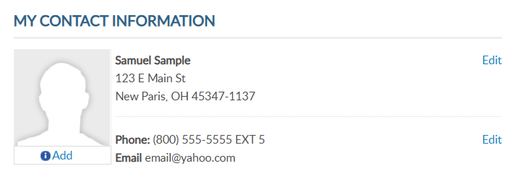
MY CONTACT INFORMATION
Primary Contact Info
Mailing Address
Phone Number
Email Address
12/31/2027
000123456789
20
5/31/2028
12/31/2027
000123456789
5
Notes:
Primary contact information is found in the center of the page. You can also edit your primary mailing address, phone number and email address. You cannot edit your name in this area. Name updates can be made using the left menu option Name and Demographics.

Slide 19
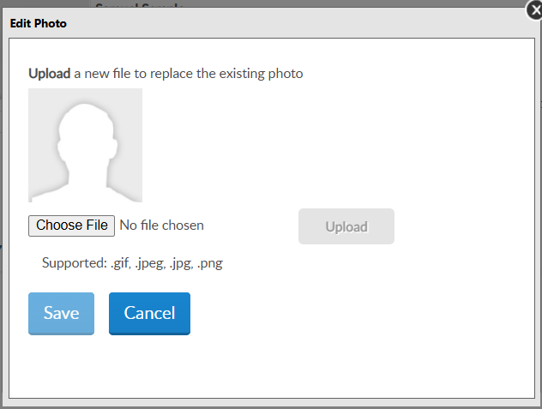
PROFILE IMAGE
Add Image
12/31/2027
000123456789
20
5/31/2028
12/31/2027
000123456789
5
Notes:
To add an image to your record, click “Add” in your profile. <1>You will be asked to choose a file. Click on “choose file” to open saved images. Note, only specified file types are supported.

Slide 20
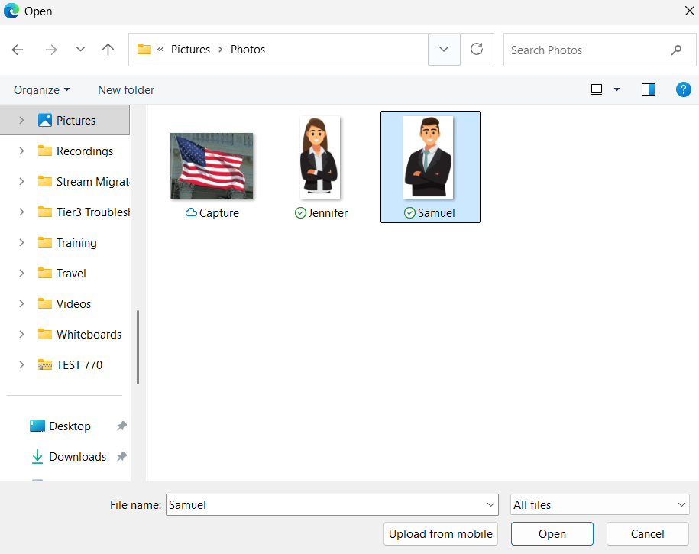
PROFILE IMAGE
Add Image
Choose file and click on image. Click “Open”.
Notes:
Once you locate the image, click on the image and select “Open”.

Slide 21
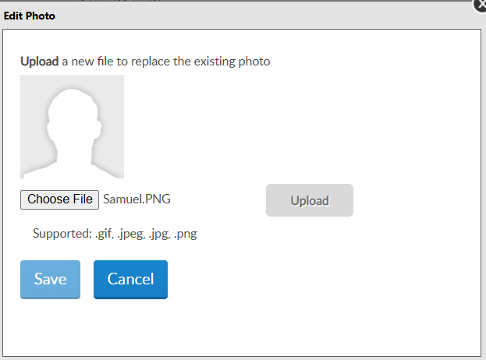
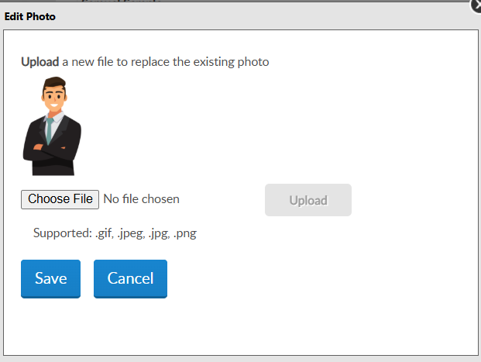
File name appears.
Click “Upload”. Preview image and “Save”.
PROFILE IMAGE
Notes:
The next step is to upload the file. After the file upload it appears for review. Click “save” to add the image.

Slide 22
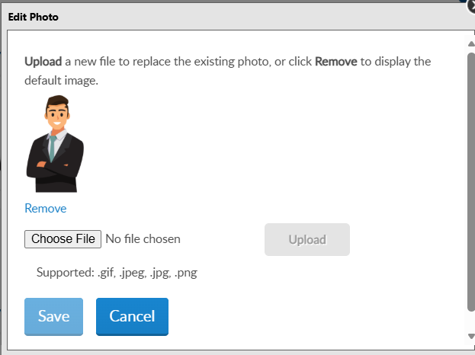
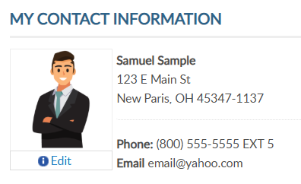
IMAGE
Edit/Remove Image
12/31/2027
000123456789
20
5/31/2028
12/31/2027
000123456789
5
Notes:
Images can be updated or removed. Click edit below the image. <1> Choose another file to replace or click “remove” to delete the image from your record.

Slide 23
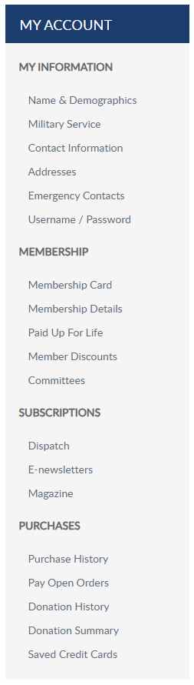
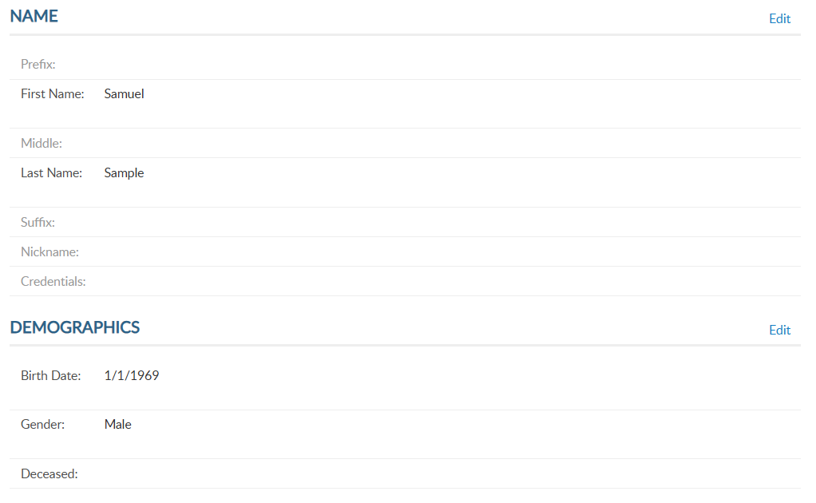
12/31/2027
000123456789
20
5/31/2028
12/31/2027
000123456789
5
Notes:
Name and demographic information allows you to update your name, date of birth and gender. If you notice your record is flagged as deceased in error, contact our department headquarters. From the left menu, select Name & Demographics to open the window.
There are 2 sections in this area. Each has an Edit option. Let’s look at the demographics section. Click edit to the right of demographics.

Slide 24
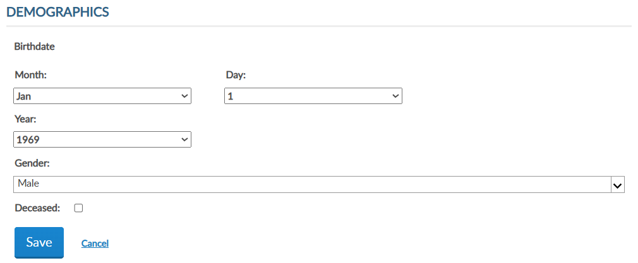
EDIT DEMOGRAPHICS
Notes:
Enter updates and save. Checking the deceased box will change member status to deceased. Deceased status will stop renewal notices, publications and subscriptions and end any committee assignments.

Slide 25
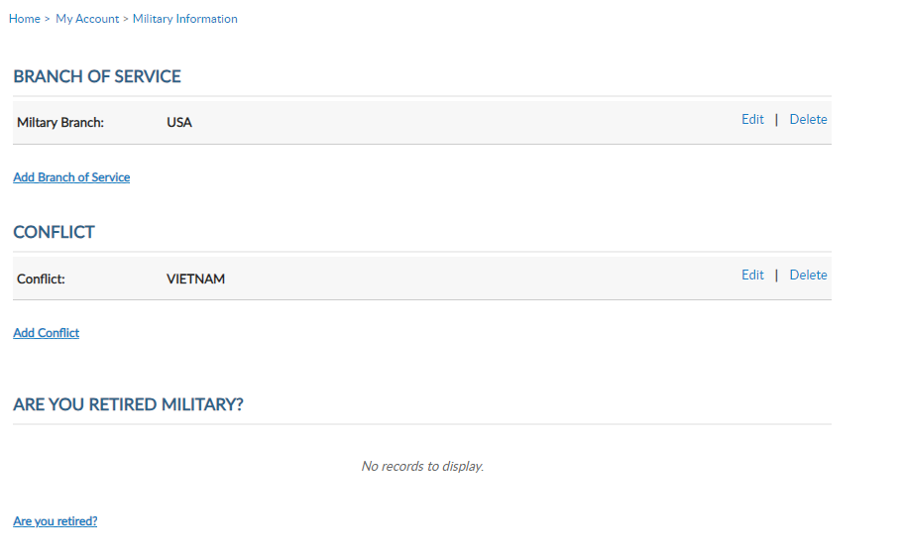
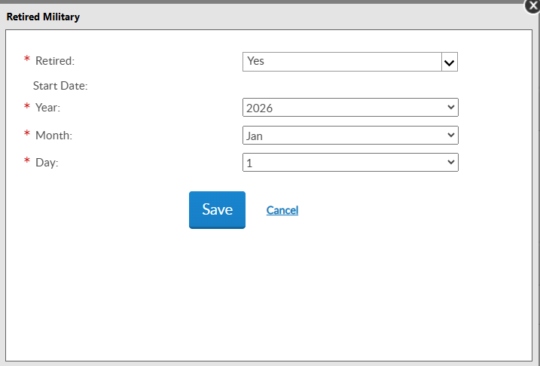
Notes:
Military service provides branch of service, conflict and retirement information and are required fields for Legion members. Using the Add, Edit or Delete links you can manage this information. Members can list multiple branches and conflicts.

Slide 26
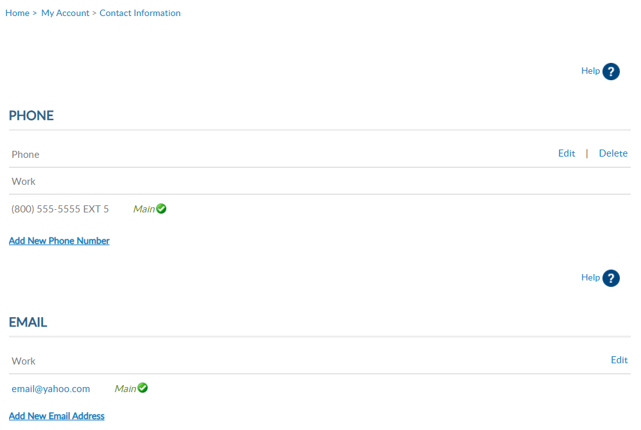

Updating your primary email address does not change your username.
Notes:
To add or remove alternate phone number or email address you must use the left menu item “Contact Information”.
Main contact information is listed on leadership rosters and reports. Use the add, update and delete links to maintain your contact information.
All phone numbers and emails will display in this window. Notice the email address does not have a delete option. Main email address information cannot be deleted. To update your email address, select the edit button. It is required to have a main email address on your membership record to have a MyLegion account.
If you are currently using your email address as your MyLegion username, updating the main email does not update your username. It does update the email associated with your account. Any future username or password requests will be sent to the primary email address on file.

Slide 27
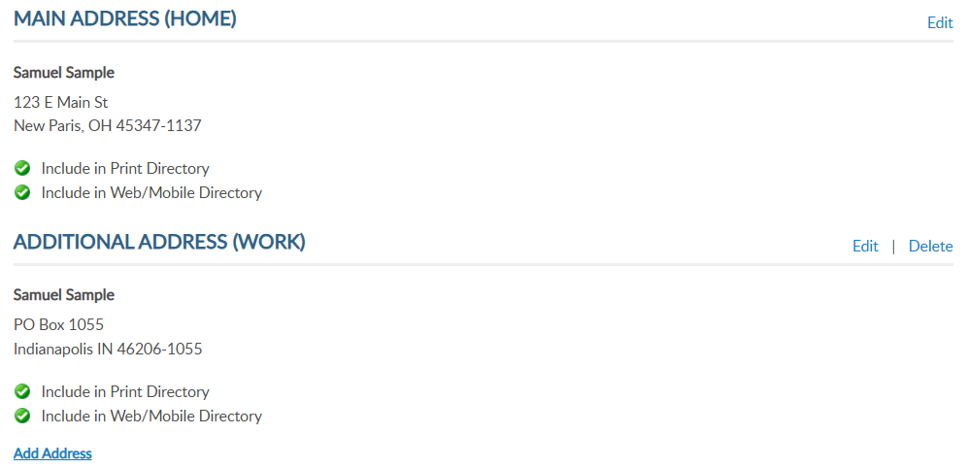
Notes:
Addresses allow you to add an alternate address and set address preferences. Information set as Main is the primary contact information and cannot be deleted.
Only one main contact can be assigned. You can add alternate address information for subscriptions and committee communications.

Slide 28
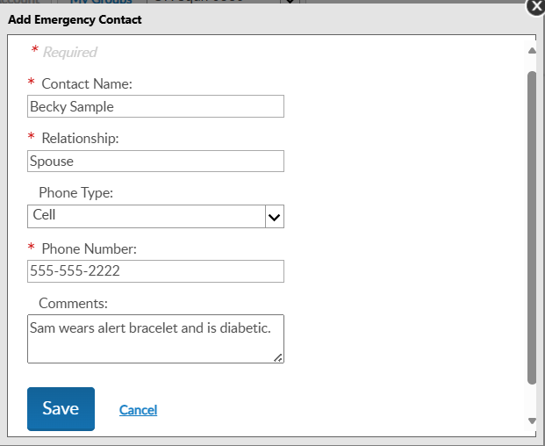
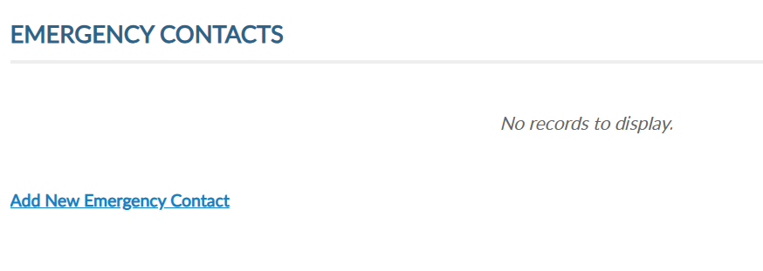

Notes:
Emergency contact information can be useful in case of an emergency if you are attending a convention, event, or visiting your local post.
Add single or multiple contacts and designate the priority of who to contact via phone. <1> Click “Add New Emergency Contact”, enter data and save.
You can add multiple contacts or delete/edit as needed.

Slide 29
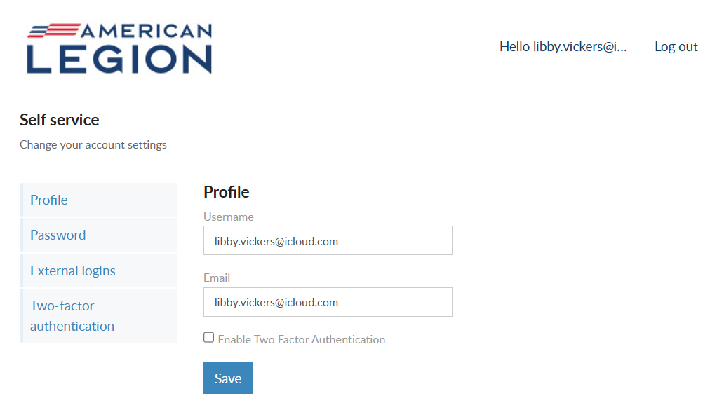

email@yahoo.com
email@yahoo.com
Notes:
Username/Password allows users to update log in credentials. This link opens a self-service window that shows your current username and primary email associated with your account.
Notice a new tab opens in your browser. When complete with reviewing or updating information, close the tab to return to your MyLegion account.
Your account profile includes username and primary email address. MyLegion accounts are associated with the primary email address on file. Your username does not have to be an email address but is recommended.
The email address listed in the self-service window is the primary, or main email address. Updating the email in Username/Password directs all future forgot username and passwords to this email.
You can also enable or disable 2 factor authentication from this window. Enter new information and save.

Slide 30
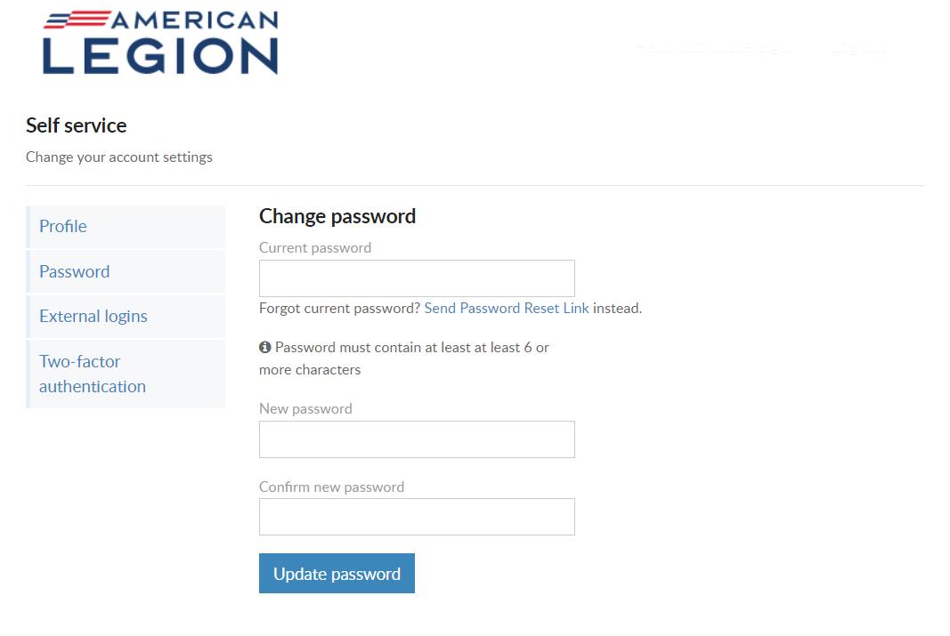
USERNAME & PASSWORD
Password
Current PW required
Must include:
        1 Lowercase Alpha
        1 Uppercase Alpha
        1 Number
        1 Symbol
        8 Character Minimum
Notes:
To update your password in the self-service window you must know your current password. If you have logged in with a saved password and do not know it, use the “Send Password Reset Link” where a link will be sent to your primary email address.
If you know your current password, enter it with the new password and click ‘Update Password’.
Password requirements include: 1 Uppercase letter, 1 Lowercase letter, 1 Number, 1 symbol, and have an eight-character minimum.

Slide 31
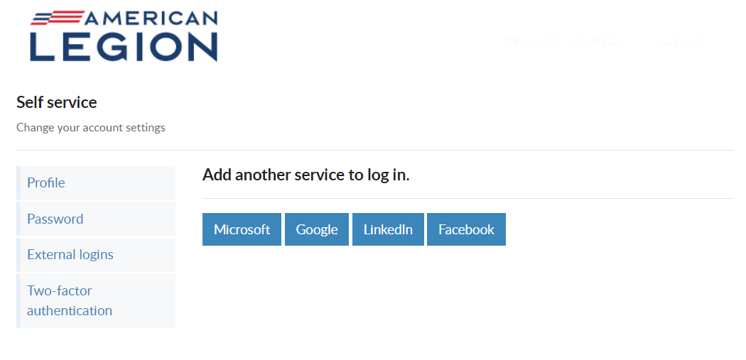
USERNAME & PASSWORD
External Logins
Notes:
Like many other web applications, myLegion users can log in using other online identities as a single sign on process. Allowing fewer passwords to remember.

Slide 32
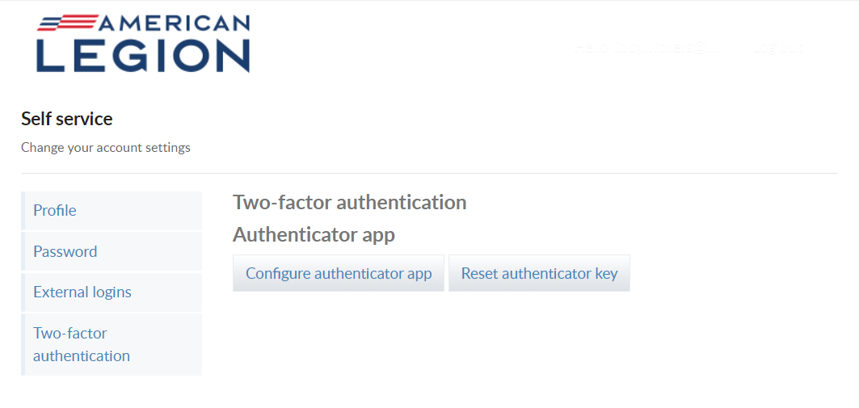
USERNAME & PASSWORD
Two-Factor Authentication
Notes:
Two-factor authentication is an extra layer of security to ensure that you're the only person who can access your account, even if someone knows your password. This extra security measure requires you to verify your identity using a randomized code we'll send you each time you attempt to log in.
If you set up 2 factor authentication, you can disable through self-service.

Slide 33

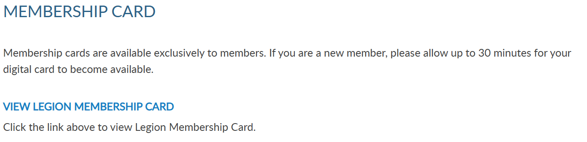
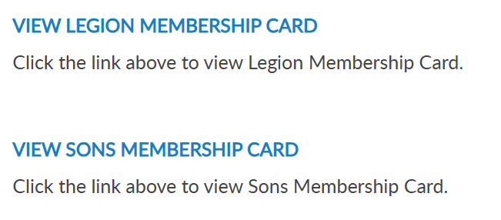

Notes:
To print your membership card, go to Membership Card.
If you are a new member, please allow up to 30 minutes for your digital card to become available.
Legion and Sons of the American Legion membership cards can be printed. Only current membership cards are available. Legion and Sons of the American Legion membership cards can be printed. Only current membership cards are available. Click the link for the card to print.

Slide 34
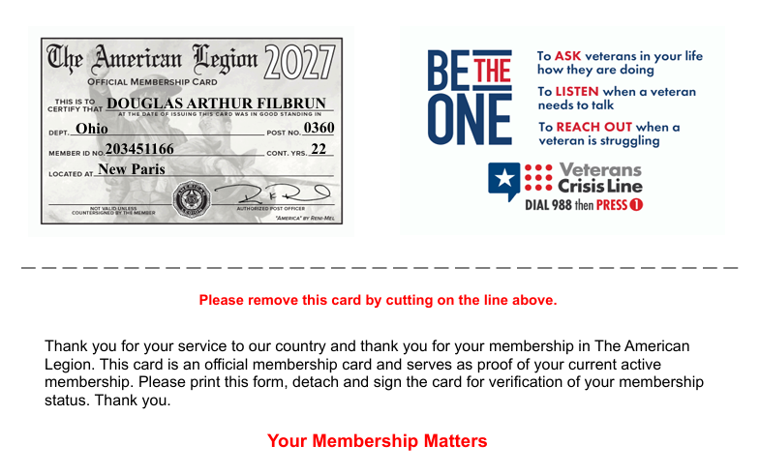

MEMBERSHIP CARDS
SAMUEL SAMPLE
123456789
20
Notes:
The card is available to print or save from your web browser. A pdf document will open in your browser to save or print.<1>

Slide 35
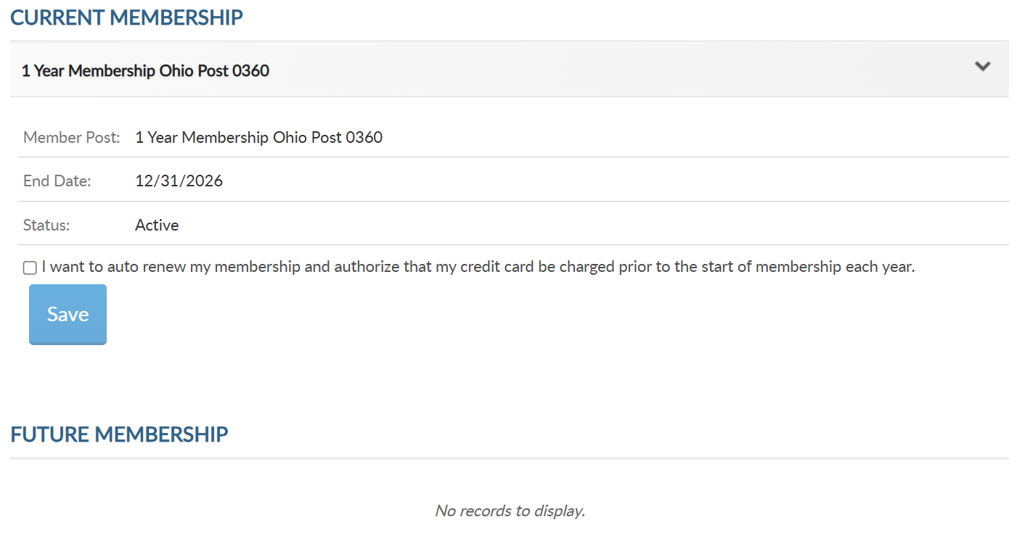

12/31/2027
Notes:
View membership status and manage automated renewal in Membership Details.
MyLegion allows you to set up auto renewal. Members set up for auto renewal will have their credit cards charged and do not receive renewal notices. Auto renew is available for both American Legion and Sons of the American Legion members. You will have to set up each auto renewal separate if you are a dual member.
A credit card must be saved prior to setting up auto renewal. Credit card information is stored in Saved Credit Cards.

Slide 36


WELCOME BACK SAMUEL!
Samuel Sample
(800) 555-5555
Samuel Sample
email@yahoo.com
123 E Main St
Notes:
The Paid Up For Life opens the paid up for life application for Legion members. The application provides a quote to purchase or set up a time payment plan.

Slide 37


Notes:
The American Legion offers exclusive discount programs for members of The American Legion and Sons of the American Legion. Discount provider information and codes are only available to members.
Discount codes are found only when logged into myLegion or legion.org. Select the area of interest to view provider contact information and exclusive discount codes.

Slide 38


Notes:
Committees list current, future and past positions reported to national headquarters. Missing information regarding your officer history can be clarified through your department headquarters.

Slide 39



Notes:
Dispatch is an American Legion National Headquarters monthly online newsletter that provides post, district and department leaders with news relevant to membership, post activities and national American Legion news.
A monthly Digital Dispatch e-newsletter is sent directly to subscribers’ email inboxes. The e-newsletter features headlines with clickable links to the full stories on the Digital Dispatch web page, www.legion.org/dispatch.

Slide 40



Notes:
E-newsletters allows you to opt in or out of online subscriptions. There are 3 sections. Flag & Emblem, Media, and Membership.
Check the box to select individual subscriptions. Unless specified these subscriptions will be emailed to the main email address on file.
Once all options are selected, save changes.

Slide 41

Notes:
Members receive a 12-month free subscription to The American Legion Magazine. This publication has gone digital. Current and past issues for 2 years are in your My Account subscriptions menu. To view past issues, go to archives using the upper menu Magazine option.
Expired members will receive an Access Denied message. Access to online magazine requires active American Legion, Sons of the American Legion membership, or paid subscription.

Slide 42



Samuel Sample
06/26/2026
Samuel Sample
6/26/2025
Samuel Sample
Notes:
Purchase history shows current open orders and history of payments made for membership and subscriptions. Expand the date range to view past payments.

Slide 43

Notes:
Donation history provides a date range search to view donations made to American Legion Charities.

Slide 44

Notes:
Members can enter, maintain, and save credit card information for auto renewal, donations, and purchases.
If no card is stored, you can add one. Go to add New Card, enter card information and Save.
At any time, you can update, remove or add another card.

Slide 45

MY ACCOUNT & HELP RESOURCES
12/31/2027
000123456789
20
5/31/2028
12/31/2027
000123456789
5
Notes:
Learn more about MyLegion using “Find Help” and go to How to use MyLegion.org.

Slide 46

Online Help
Notes:
Step by step instructions, videos and training presentations will assist with how to manage your member account and groups in MyLegion.

Slide 47
MYLEGION SUPPORT
MyLegion@legion.org
833.253.9995
Monday – Friday
8:00am – 4:30pm
(Eastern)
The American Legion National HQs
5745 Lee Road
Indianapolis, IN 46216
Contact your MyLegion support team to assist with any questions or tools on your MyLegion account.
Notes:
Contact your myLegion support team to assist with questions and tools for MyLegion. Email mylegion@legion.org or call 833-253-9995 Monday through Friday.

